Slide 1
Outline
The concept of Dynamic Equilibrium
The Equilibrium Constant
Heterogeneous Equilibria and Ksp
LeChatlier’s Principle

Slide 2
Chemical Equilibrium
Many chemical reactions do not react to completion.
Equilibrium is the point where the amounts of products and reactants stop changing.
The forward and reverse reactions continue, but at the same rate

Slide 3
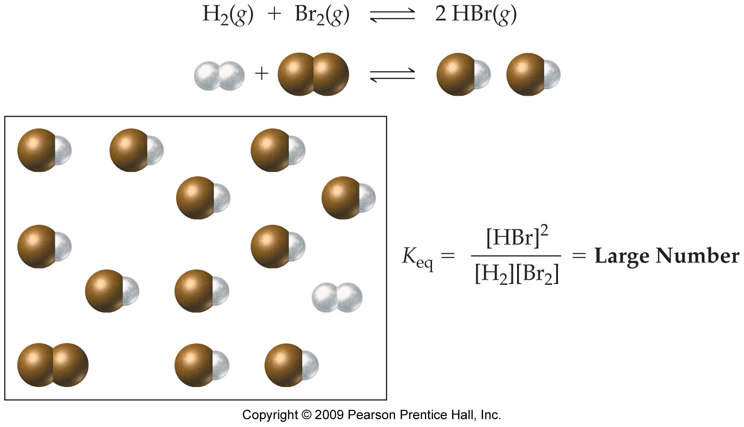
A Large Equilibrium Constant (Equilibrium Favors Products)

Slide 4
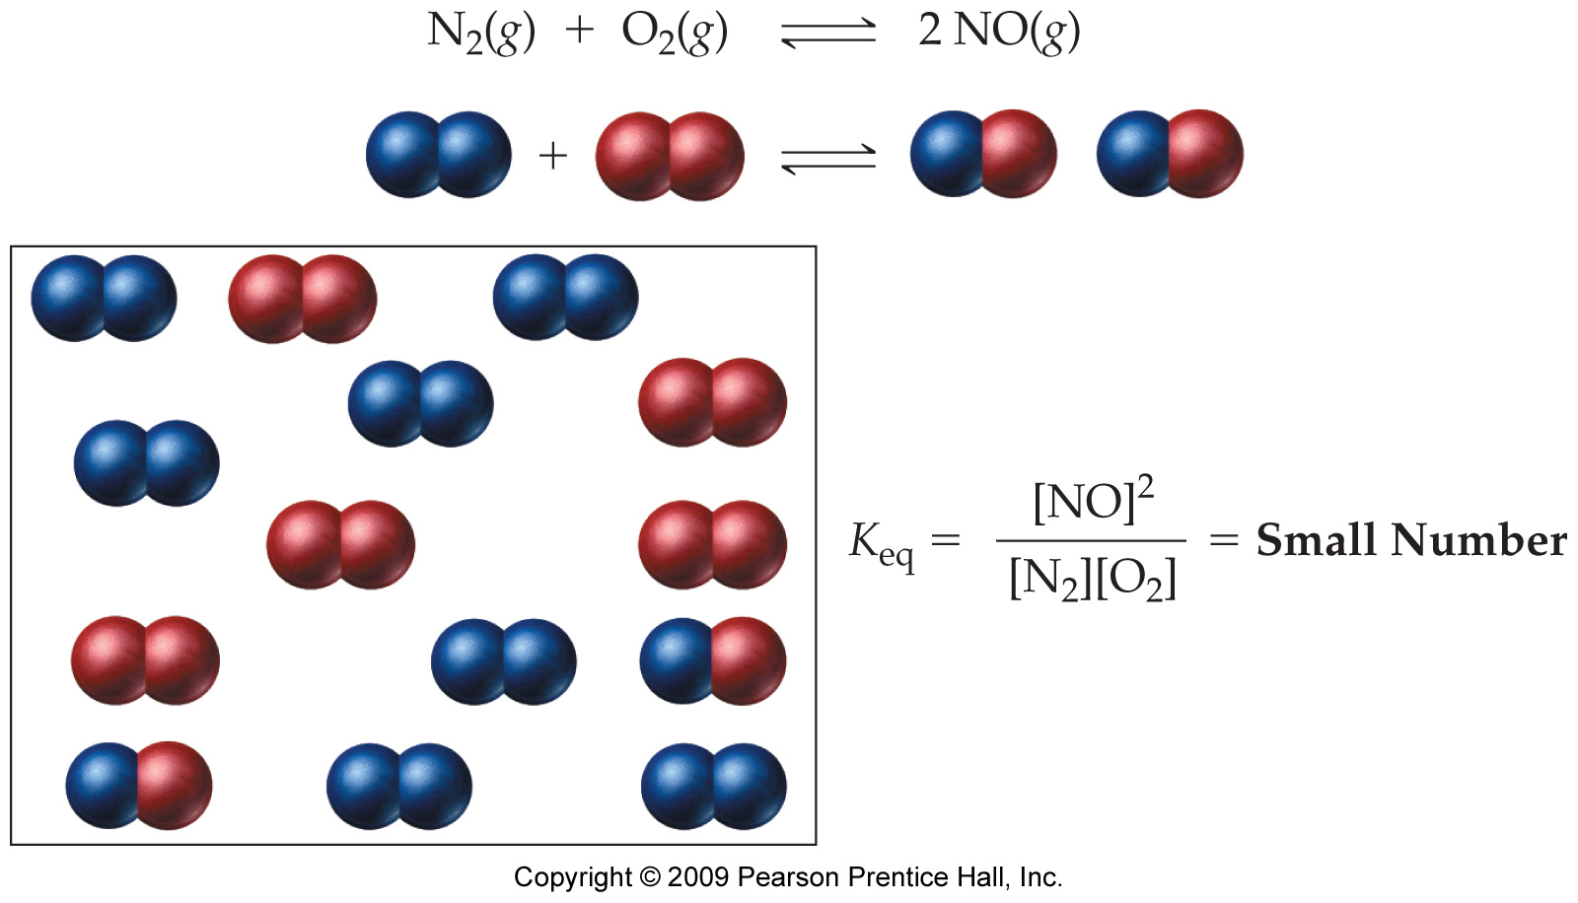
A Small Equilibrium Constant (Equilibrium Favors Reactants)

Slide 5
Outline
The concept of Dynamic Equilibrium
The Equilibrium Constant
Heterogeneous Equilibria and Ksp
LeChatlier’s Principle

Slide 6
Equilibrium Constant
For the general equation aA + bB ⇔ cC + dD, the relationship is given below:
The equilibrium constant, K_{eq}.
*Always Products / Reactants

Slide 7
Equilibrium Constant
For the reaction H₂(g) + I₂(g) ⇔ 2HI(g) at equilibrium.
Products
Reactants

Slide 8
Equilibrium Constant
For the reaction H₂(g) + I₂(g) ⇔ 2HI(g) at equilibrium.
Products
Reactants

Slide 9
A Large Equilibrium Constant (Equilibrium Favors Products)

Slide 10
A Small Equilibrium Constant (Equilibrium Favors Reactants)

Slide 11
Write the Equilibrium Constant Expressions, K_{eq}, and Predict the Position of Equilibrium for Each of the Following:
2 SO₂(g) + O₂(g) ⇔ 2 SO₃(g) K_{eq} = 8 x 10²⁵
N₂(g) + 2 O₂(g) ⇔ 2 NO₂(g) K_{eq} = 3 x 10⁻¹⁷

Slide 12
Write the Equilibrium Constant Expressions, K_{eq}, and Predict the Position of Equilibrium for Each of the Following, Continued:
2 SO₂(g) + O₂(g) ⇔ 2 SO₃(g) K_{eq} = 8 x 10²⁵
N₂(g) + 2 O₂(g) ⇔ 2 NO₂(g) K_{eq} = 3 x 10⁻¹⁷
Favors products.
Favors reactants.

Slide 13
Calculate K_{eq} for the Reaction 2 NO₂(g) ⇔ N₂O₄(g) at 100 °C if the Equilibrium Concentrations Are [NO₂] = 0.0172 M and [N₂O₄] = 0.0014 M.

Slide 14
Find the Value of K_{eq} for the Reaction 2 NO₂(g) ⇔ N₂O₄(g).
Given:
Find:
[NO₂] = 0.0172 M, [N₂O₄] = 0.0014 M
K_{eq}
Solution Map:
Relationships:
[NO₂], [N₂O₄]
K_{eq}
Solve:
Check:
K_{eq} is unitless.

Slide 15
A Sample of PCl₅(g) Is Placed in a 0.500 L Container and Heated to 160 °C. The PCl₅ Is Decomposed into PCl₃(g) and Cl₂(g). At Equilibrium, 0.203 Moles of both PCl₃ and Cl₂ Are Formed. Determine the Equilibrium Concentration of PCl₅ if K_{eq} = 0.0635.

Slide 16
A Sample of PCl₅(g) Is Placed in a 0.500 L Container and Heated to 160 °C. The PCl₅ Is Decomposed into PCl₃(g) and Cl₂(g). At Equilibrium, 0.203 Moles of PCl₃ and Cl₂ Are Formed. Determine the Equilibrium Concentration of PCl₅ if K_{eq} = 0.0635, Continued.
PCl₅ ⇔ PCl₃ + Cl₂
Equilibrium Concentration, M | ?
Notes:
if in addition you calculate K_{p} from K_{c} you find that it is 2.26, slightly greater than 1 – showing that the equilibrium constant may be unreliable for predicting the position of equilibrium when it is close to 1

Slide 17
Outline
The concept of Dynamic Equilibrium
The Equilibrium Constant
Heterogeneous Equilibria and Ksp
LeChatlier’s Principle

Slide 18
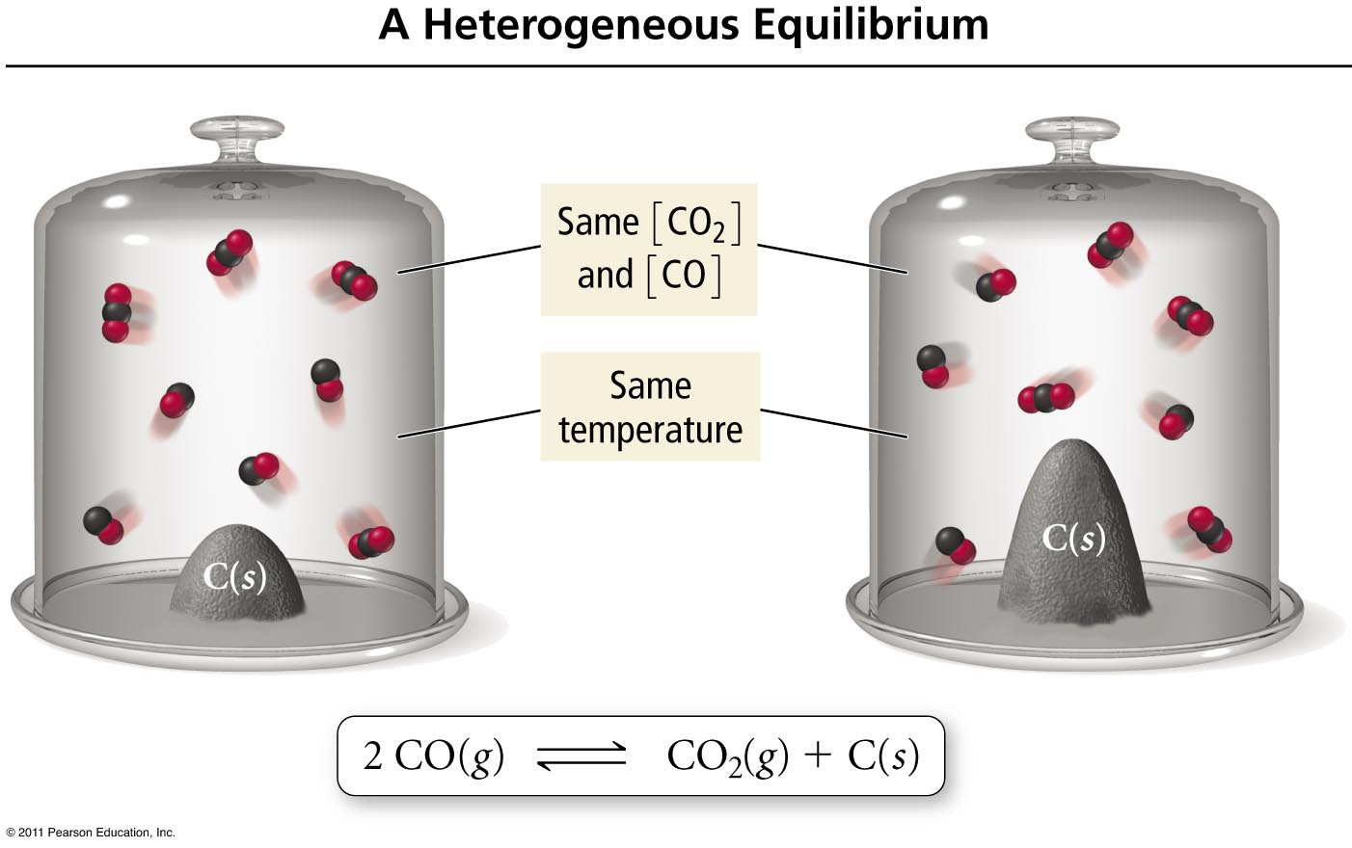
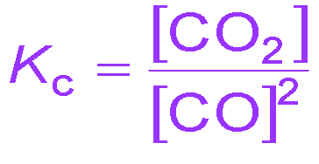
Heterogeneous Equilibria
Only concentrations of elements and compounds in the reaction mixture are included in Keq.
* Usually (g) and (aq)
Concentrations of pure chemicals are not included.
* Usually (s) and (l)

Slide 19
Write the Equilibrium Constant Expressions, K_{eq}, for Each of the Following:
2 CO₂(g) ⇔ 2 CO(g) + O₂(g)
BaSO₄(s) ⇔ Ba⁺²(aq) + SO₄⁻²(aq)
CH₄(g) + 2 O₂(g) ⇔ CO₂(g) + 2 H₂O(l)

Slide 20
Write the Equilibrium Constant Expressions, K_{eq}, for Each of the Following
2 CO₂(g) ⇔ 2 CO(g) + O₂(g)
BaSO₄(s) ⇔ Ba⁺²(aq) + SO₄⁻²(aq)
CH₄(g) + 2 O₂(g) ⇔ CO₂(g) + 2 H₂O(l)
[CO]²•[O₂]
[CO₂]²
K_{eq} =
K_{eq} =
[Ba⁺²]•[SO₄⁻²]
[CO₂]
[CH₄]•[O₂]²
K_{eq} =

Slide 21
Outline
The concept of Dynamic Equilibrium
The Equilibrium Constant
Heterogeneous Equilibria and Ksp
LeChatlier’s Principle

Slide 22


Slide 23
Le Châtelier’s Principle
“When a chemical system at equilibrium is disturbed, the system shifts in a direction that will minimize the disturbance.”
Adding reactant will cause shift to right (products) to reestablish equilibrium.
Adding product will cause shift to left (reactants) to reestablish equilibrium
Increasing pressure will shift to lower pressure by decreasing moles of gas
Increasing temperature will shift to absorb heat (left for exothermic, right for endothermic)

Slide 24
Practice – Le Châtelier’s Principle
The reaction 2 SO₂(g) + O₂(g) ⇔ 2 SO₃(g) with ΔH° = −198 kJ is at equilibrium. How will each of the following changes affect the equilibrium concentrations of each gas once equilibrium is restored?
adding more O₂ to the container
condensing and removing SO₃
compressing the gases
cooling the container
doubling the volume of the container
warming the mixture
adding the inert gas helium to the container
Tro: Chemistry: A Molecular Approach, 2/e

Slide 25
The reaction 2 SO₂(g) + O₂(g) ⇔ 2 SO₃(g) with ΔH° = −198 kJ is at equilibrium.
adding more O₂ to the container shift to SO₃
condensing and removing SO₃ shift to SO₃
compressing the gases shift to SO₃
cooling the container shift to SO₃
doubling the volume of the container shift to SO₂
warming the mixture shift to SO₂
adding helium to the container no effect

